Slide 1
CS61B Discussion 2
Scope, Pass-by-Value, Static

Slide 2
Administrivia
Lab 1 and Lab 2 due this Friday 1/26 at midnight.
Note, all labs are due Friday at midnight.
Proj0 NBody also due Friday at midnight.
If you haven’t started please start ASAP!
One-on-one tutoring will be made available weekly from now on! Check Piazza for details.
Office hours and exam prep sections start this week! See calendar on the course website and Piazza post @274.
Attendance will be done through the quiz and the form at tinyurl.com/disc2-cz

Slide 3
Review: Defining classes
// class definition
public class IntList {
// instance variables
int head;
IntList tail;
// constructors, which will create IntList objects
public IntList() {...}
public IntList(int value, IntList tail) {...}
// you can create methods that use the instance variables!
public void insert(int val) {...}
public void removeLast() {...}
}
Notes:
You can try getting the students to write an example class together! Have a student tell you what kind of class they’d like to make (maybe ask for favorite food or animal?) Then ask people to raise their hand and give some attributes for that thing which you can use as instance variables.

Slide 4
Review: Primitives and Reference
Primitives:
byte, short, long, int, double, float, char, boolean
References:
Everything else!
Objects, arrays, Strings, etc.
Golden Rule of Equals AKA pass-by-value
When you do “a = b”, you always copy the bits of b into a.
For primitives: Directly copy the value inside b to a.
For Reference types: Copy the memory address of b into a.
Also can say “copies the pointer in b to a”
Notes:
Ask the students: “Anyone know what the primitive types are?”
also ask: “Give me some examples of Reference types”

Slide 5
Review: Box and Pointer Diagrams
Box and Pointers are the 61B equivalent of 61A’s environment diagram
They are crucial to helping us keep track of what goes on in a program: use them!
We didn’t specify what integers are going in the array, so Java initializes it with the default value 0
int x = 29;
int[] arr = new int[3];
Int x
int[ ] arr
29
0
0
0
Primitives go in the box
Reference types are referenced via pointers

Slide 6
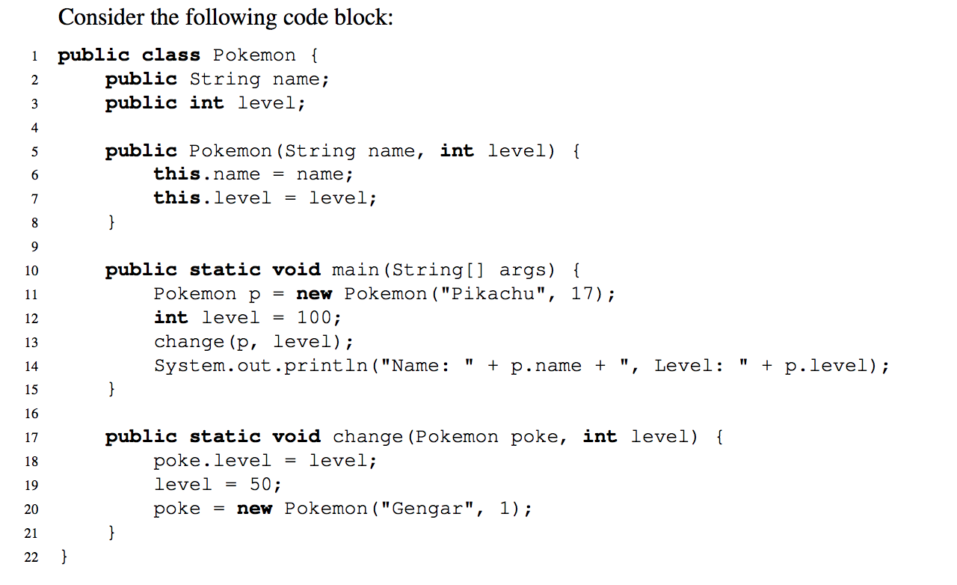
Pass by What?
Java Visualizer
Notes:
We wanna know what’s happening inside “main”
We start at this line.
Draw out the box and pointer diagrams on the board. Ask the students to tell you what to draw at each line

Slide 7
Review: Static
Public class Dog{
public int legs;
public static String name = “Doge”;
public static void bark() {...}
public static void main(String[] args) {
Dog Fido = new Dog();
}
}
Static variables are shared by all instances of the class and should be accessed via dot notation with the class, not the instance.
Dog.name instead of Fido.name
Static methods are methods that do not require an instance to call it, and thus do not access any instance variables.
Dog.bark();
You can call static methods on an instance, but what will happen is Java will actually look for the static type of the object and run the method from that class.
Dog g = new Dog();
g.bark();
=
Dog g = new Dog();
Dog.bark();

Slide 8
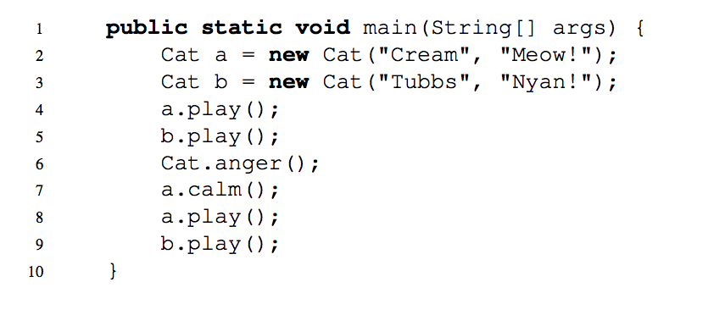
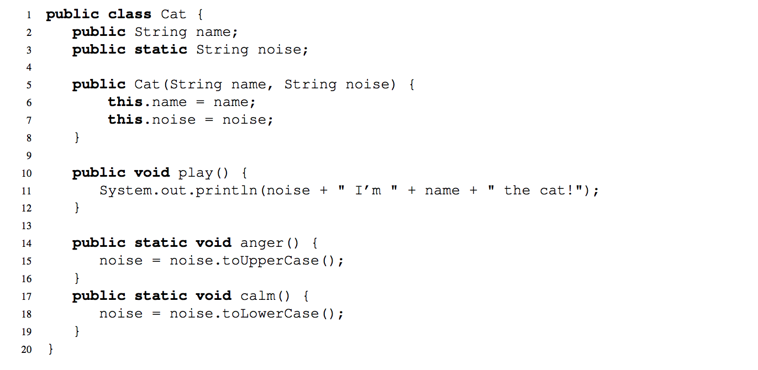
2) Static Methods and Variables
Java Visualizer

Slide 9
Review: IntLists
IntLists are the equivalent of 61A’s “Linked List” with one restriction: it can only hold integers.
Each IntList consists of 2 elements:
an integer first
an IntList rest
IntList l first rest
1
2
3

Slide 10
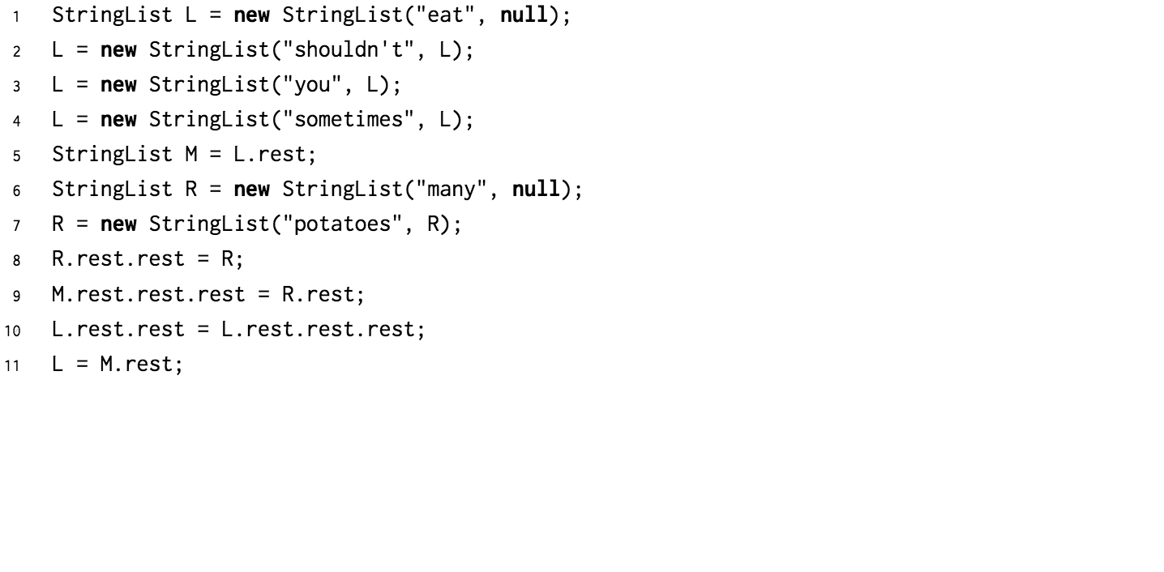
3) Practice with Linked Lists
Java Visualizer
Notes:
Can walk through the solution with them on the board or use Java visualizer

Slide 11
4) Extra: Squaring a List
Components of recursion:
Base case
Recursive call
Composition

Slide 12
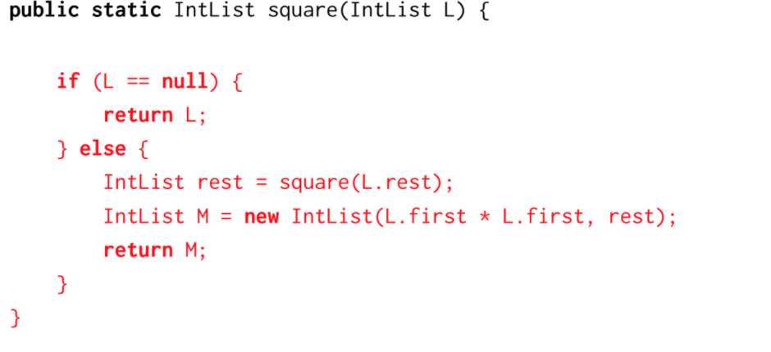
4) Extra: Squaring a List
Components of recursion:
Base case
Recursive call
Composition

Slide 13
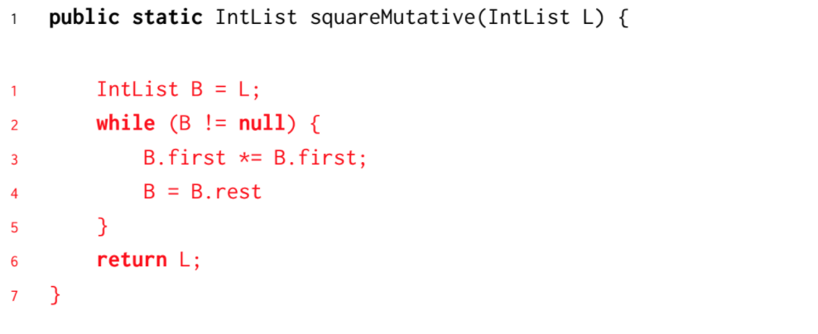
4) Extra: Squaring a List
Components of recursion:
Base case
Recursive call
Composition

